Slide 1



PREVENTIVE MONITORING of the project:
619451-EPP-1-2020-1-NL-EPPKA2-CBHE-JP
INTERNATIONAL STUDENTS
ADAPTATION AND INTEGRATION /
INTERADIS
YURIY FEDKOVYCH CHERNIVTSI NATIONAL UNIVERSITY

Slide 2



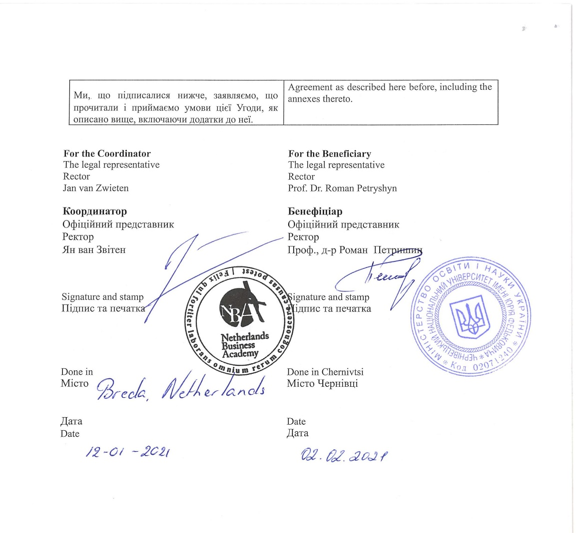
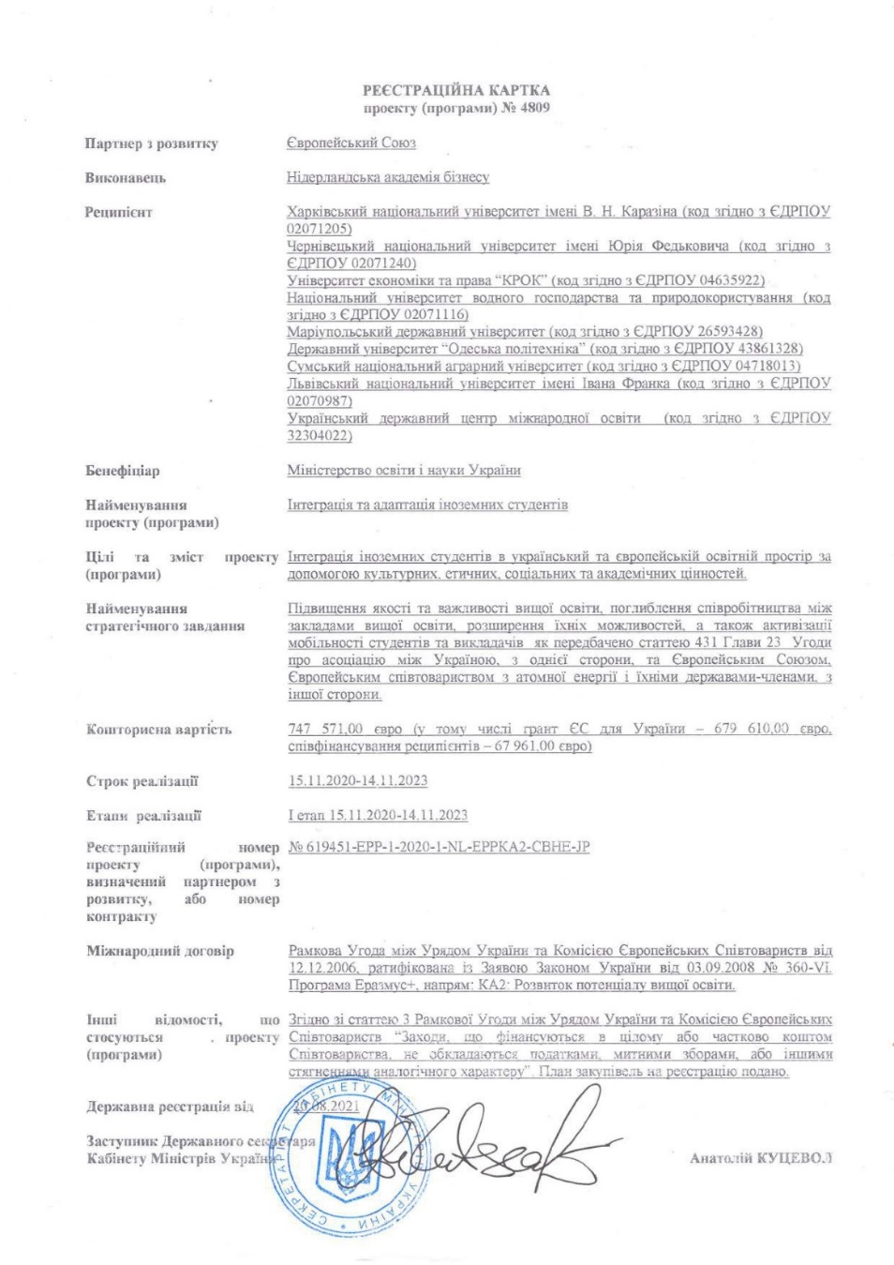
STATE PROJECT REGISTRATION
PARTNERSHIP AGREEMENT
PROJECT LEGAL INSTRUMENTS

Slide 3
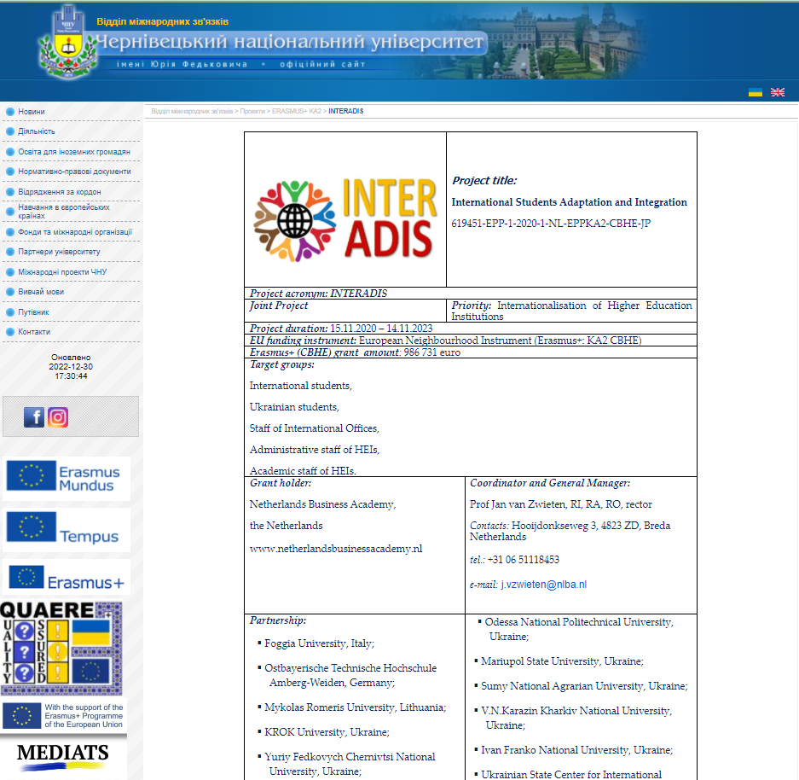
INFORMATION ABOUT THE INTERADIS PROJECT
Information about the Project on the website of your HEI, Eng | http://interof.chnu.edu.ua/index.php?page=ua/10projects/page%2006/page06 http://interof.chnu.edu.ua/index.php?page=en&data[409][id]=13110
Information about the Project on the website of your HEI, Ukr | http://interof.chnu.edu.ua/index.php?page=ua/archive&data[661][news_id]=13108

Slide 4
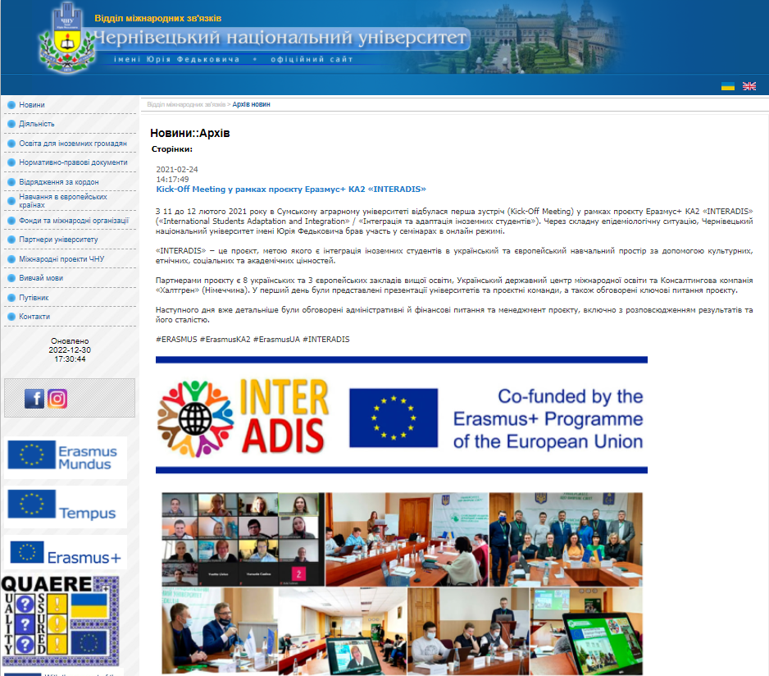
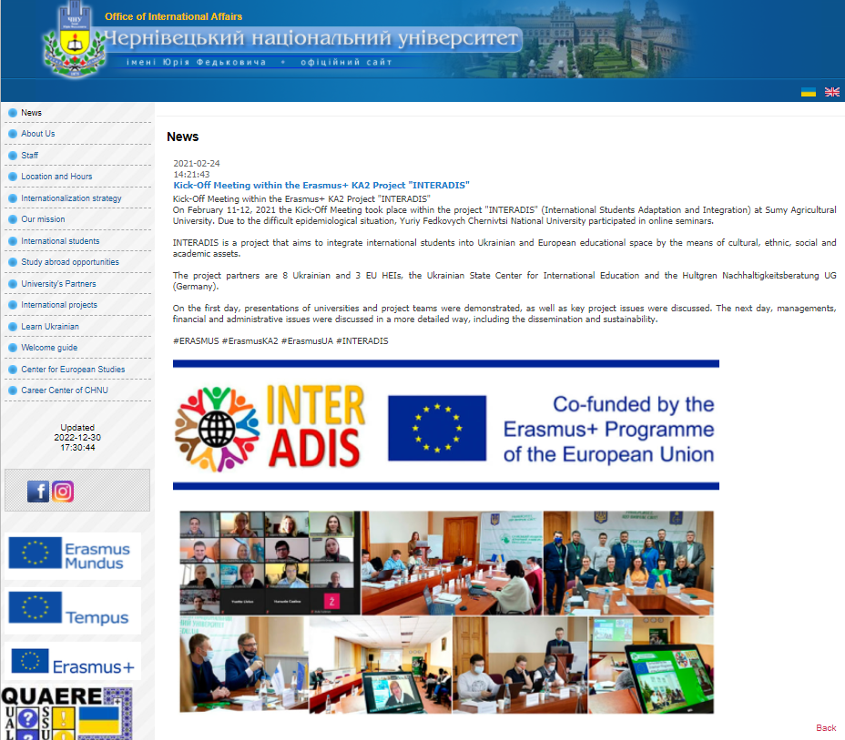
NEWS ON KICK-OFF MEETING

Slide 5
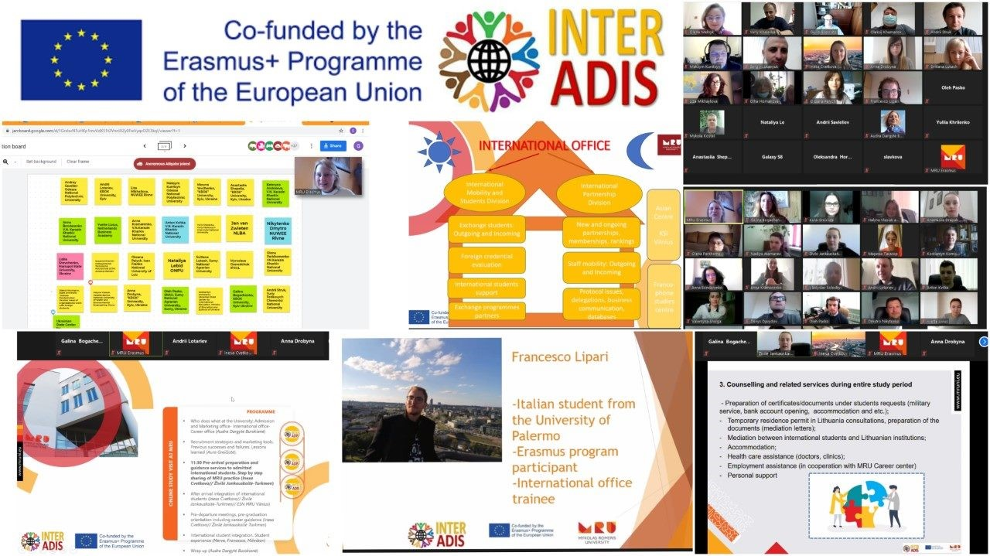
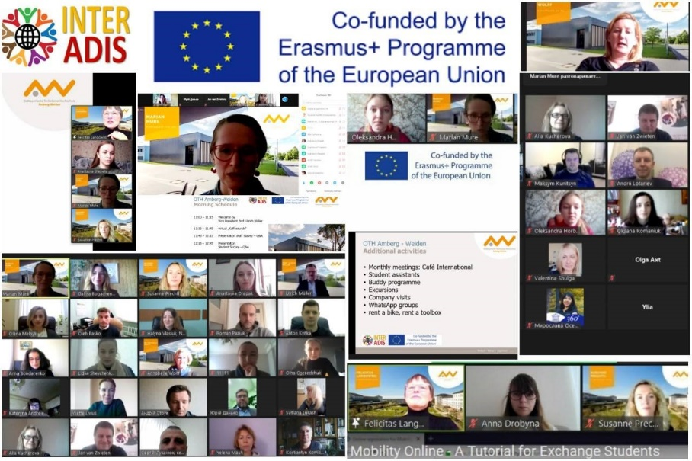
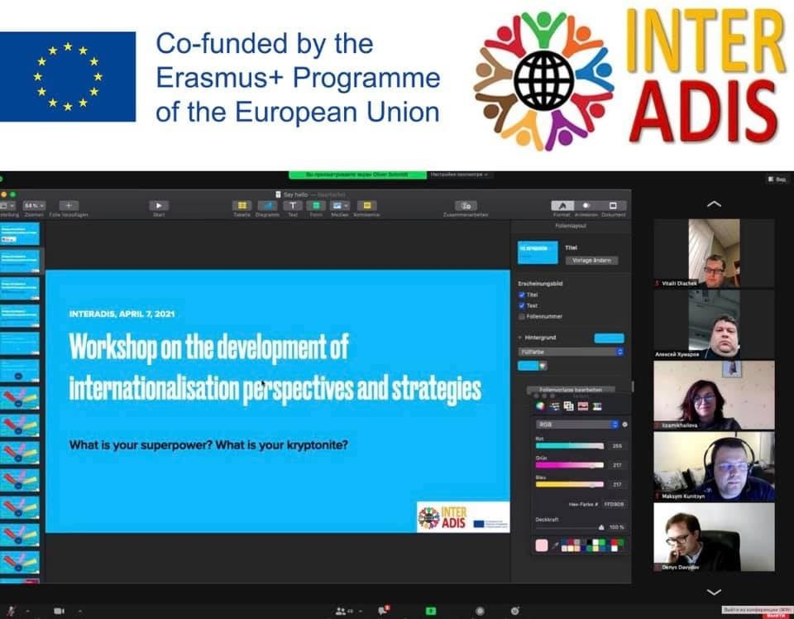
NEWS ON ONLINE STUDY VISITS
News on SV 1 HUG | http://interof.chnu.edu.ua/index.php?page=ua&data[343][id]=14313 https://www.facebook.com/interofchnueduua/posts/2791114304535575
News on SV 2 MRU | http://interof.chnu.edu.ua/index.php?page=ua&data[343][id]=14315 https://www.facebook.com/interofchnueduua/posts/2791118957868443
News on SV 1 OTH Amberg Weiden | http://interof.chnu.edu.ua/index.php?page=ua&data[343][id]=14317 https://www.facebook.com/interofchnueduua/posts/2791123981201274
News on SV 1 NLBA | http://interof.chnu.edu.ua/index.php?page=ua&data[343][id]=14341 https://www.facebook.com/interofchnueduua/posts/2792420214404984
News on SV 1 UNIFG | http://interof.chnu.edu.ua/index.php?page=ua&data[343][id]=14420 https://www.facebook.com/interofchnueduua/posts/2798212170492455

Slide 6
ROADMAP DEVELOPMENT
FOR INTERNATIONAL STUDENTS
DATA
DESIGN
INFORMATION WAS COLLECTED AND ANALYZED
GUIDELINES INCLUDE QR-CODES AND CLICKABLE LINKS
ELABORATION
LAUNCH
GUIDELINES WERE DEVELOPED
GUIDELINES WERE UPLOADED ON THE INTERNATIONAL OFFICE WEBSITE
http://interof.chnu.edu.ua/index.php?page=ua/02interstud

Slide 7
ADAPTATION COURSE DEVELOPMENT
FOR INTERNATIONAL STUDENTS
PREPARATION
LECTURER
MEETING
DEVELOPMENT
VIDEO
TOPIC IS CHOSEN
CROSS-CULTURAL COMMUNICATIONS
NATALIYA NECHAYEVA-YURIYCHUK, PH.D.
IN SUMMER 2021, THE ONLINE MEETING WITH LECTURERS WAS HELD
THEMATIC PLAN OF THE COURSE IS ELABORATED, CONTENT IS IN THE PROCESS OF DEVELOPMENT
VIDEO LECTURES ARE TO BE RECORDED

Slide 8
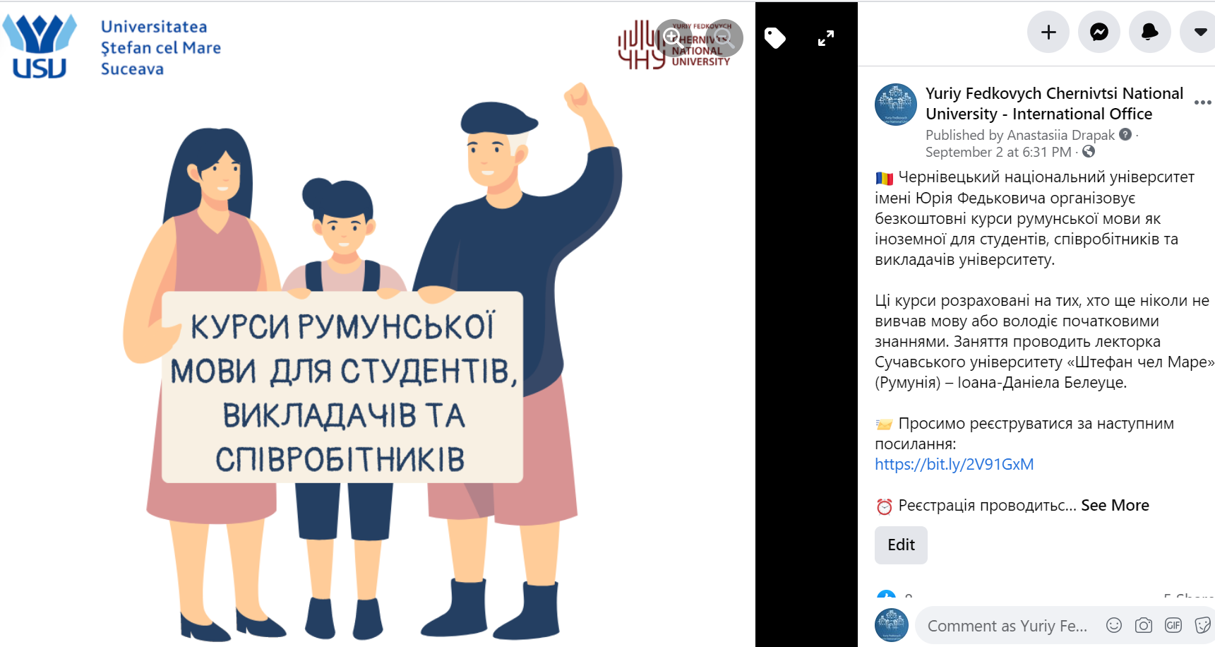


LANGUAGE COURSES FOR STUDENTS AND UNIVERSITY STAFF

Slide 9
PROJECT FINANCIAL MANAGEMENT
TOTAL COSTS: 80 989,00 EUR
Staff costs - 22 314,00 EUR
Travel costs - 14 515,00 EUR
Costs of stay - 32 260,00 EUR
Equipment costs - 10 000,00 EUR
Subcontracting costs - 1 900,00 EUR
USED COSTS: 1 278,00 EUR
Staff costs – 1 278,00 EUR

Slide 10
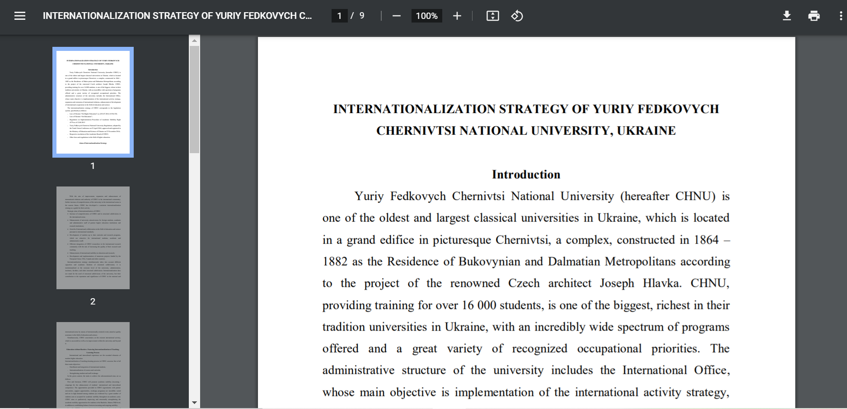
INTERNATIONALIZATION STRATEGY OF THE CHNU

Slide 11
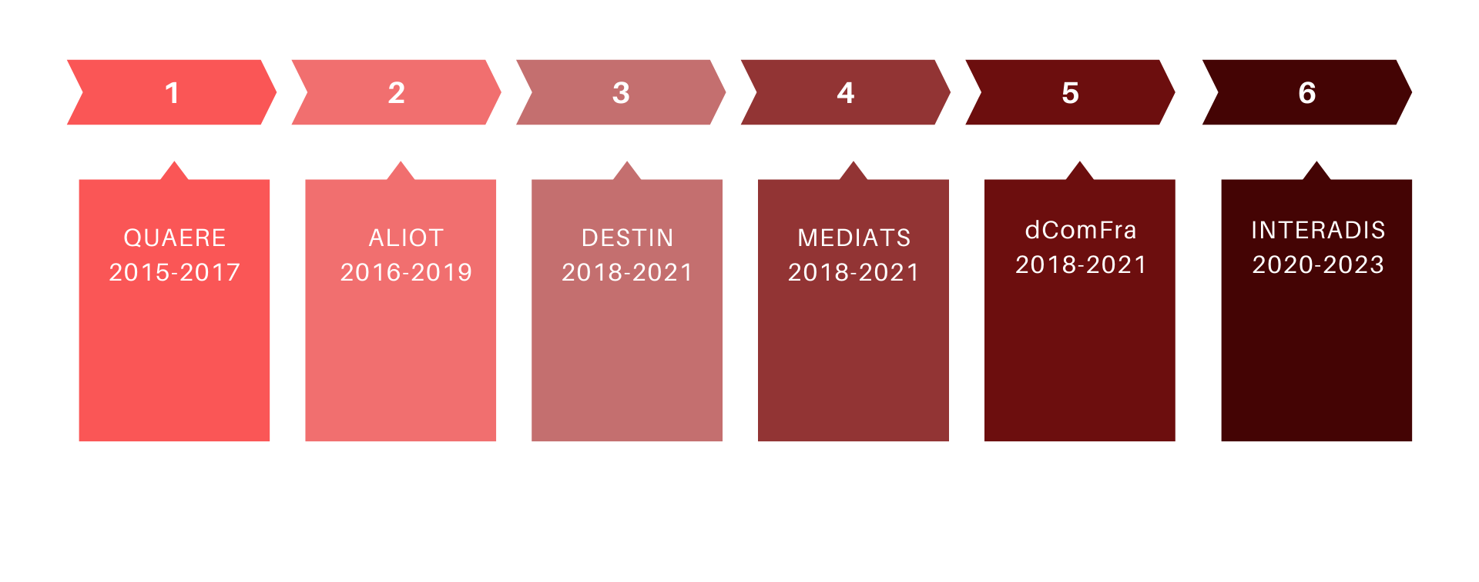
ERASMUS+ KA107 AND KA2 https://bit.ly/CHNU_KA107

Slide 12
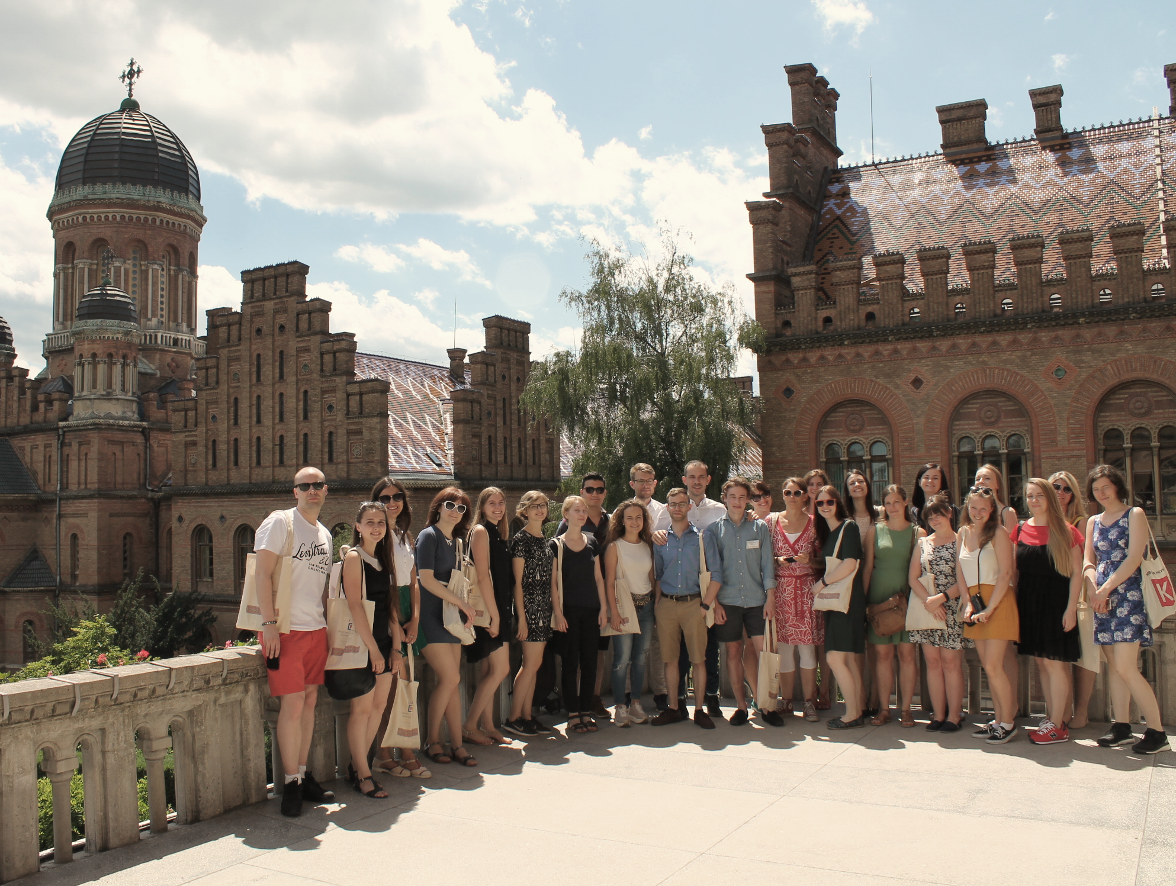
THANK YOU FOR YOUR ATTENTION!
Q&A
1 OCTOBER 2021

